Slide 1
SPEAKING TEST: 3 PARTS

Slide 2
PART ONE

Slide 3
PART TWO
SPEAKING

Slide 4
COMMON EXPRESSIONS
I suppose I would choose to learn English at a center because of two reasons.
As compared to chinese and japanese, English is much easier to learn
As compared to some fruits or cakes, flowers are more meaningful, romantic and easy to buy
Comedy is not my taste.
I am not interested in ................since/ because

Slide 5
PART THREE

Slide 6
The effects of Technology on Teenagers
Imagination is unnecessary
[Your own idea]
Memory is inhibited
Lack of outside activities

Slide 7
Personally i think/ in my opinion, there are four main bad effects of Technology on Teenagers
Firstly, Imagination is unnecessary. Technology makes you lazy to think and you become less creative
Secondly, It is lack of outside activities. Teenagers spend most of their free time playing online games, chatting with friends online, watching online movies or listening to music instead of playing football or walking in the park.
Thirdly, Memory is inhibited. Young people depends too much on computer mobile phone and they don’t remember well or they have short memories.
Finally, it Kills their free time. They spend too much time on internet instead of playing sports or hanging out with friends. It is not good for their health. Using computers for a long time can damage your eyes, your back.

Slide 8
BENEFITS OF TOURISM
Revenue
Restoration of cultural values
Tourism industry
Job opportunities for local people
[Your own idea]

Slide 9
Personally i think/ in my view, there are four benefits of tourism
Firstly, It Brings a lot of revenue.
Secondly, It helps to restore cultural values
Thirdly, It helps to create jobs for local people.
Finally, It is a green and friendly industry. It does not pollute the air, the land and water. To protect the natural landscapes, the city officials ask the visitors to obey the rules and respect the places you visit.

Slide 10
Topic: Reading habit should be encouraged among teenagers.
Reading
improves memory
reduces stress
[your own ideas]
increases knowledge

Slide 11
Benefits of Reading
relaxing
ways of self-educating
[your own ideas]
stimulating your mind

Slide 12
Personally i think/ in my opinion, there are four main benefits of reading books
Firstly, it helps you stimulate your mind. Reading book is the best exercise for your mind.
Secondly, reading books makes you feel relaxed and reduce stress
Thirdly, it is a good way of self-educating. People with good reading habit can set up their own study timetable and follow it strictly.
Finally, it helps them improve their language skills and memories. It helps them read and write well. They can enrich their vocabulary and express their ideas clearly. Besides, reading books helps them have long memory. There is a lot of information in your brain and reading books makes your brain strong with long memory

Slide 13
TASTE
BALANCE
FICTION BOOKS >< NON FICTION BOOKS

Slide 14
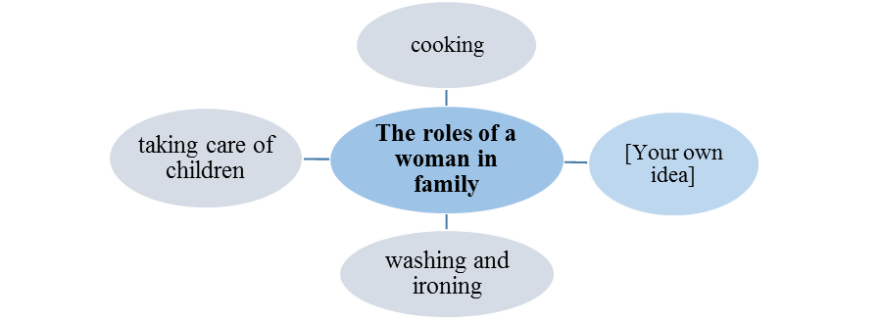
The roles of a woman in family

Slide 15
Personally i think/ in my opinion, there are four main roles of women in a family
Firstly, That is cooking. Women have to cook lunch, dinner for their families.
Secondly, They have to take care of their children. They have to feed them, take them to school and so on.
Thirdly, They have to do washing, ironing and cleaning.
Finally, They have to go to work to support their family. They need salary to buy food, clothes, medicine and pay tuition fee for their children. I think their husband’s salary is not big enough to spend on a family.

Slide 16
BENEFITS OF LEARNING FOREIGN LANGUAGES
The importance of learning languages
making friends
[Your own idea]
getting a scholarship
going abroad to study

Slide 17
Personally i think/ in my opinion, there are four main benefits of learning foreign languages.
Firstly, It helps you to make friends. Speaking a foreign language enables you to communicate with other foreigners and have better relationship.
Secondly, It helps you to study abroad. Learning a foreing langugage give you more chances to come to other countries to study and gain more knowledge.
Thirdly, It helps you to get scholarship
Finally, It helps you to find a good job with high salary. Many big company requires job applicants to speak English or Chinese well to talk and work with foreign clients. You can talk or email them in that foreign language.

Slide 18
Benefits of keeping a pet
Keeping a pet
love of animals
[Your own idea]
responsibility
care for others

Slide 19
Personally i think/ in my opinion, there are four main benefits of keeping a pet
Firstly, It helps you love animals
Secondly, it helps you learn how to cares for others
Thirdly, It helps you have more responsibility.
Finally, You can have a best friend. It is said that pet such as dogs and cats are very loyal and friendly. You can play with them in the park, talk to them and share your problems with them.

Slide 20
REASONS FOR BANNING SMOKING
Reasons for banning smoking
air pollution
[Your own idea]
influence on non-smokers
fires

Slide 21
Personally i think/ in my view, there are four main reasons to ban smoking
Firstly, It causes air pollution. Smoke from cigarretes pollutes the air and damages ozone layer.
Secondly, It causes fire. Cigarette end is one of the factors leading cause of fire in many places.
Thirdly, It has negative/bad effects on non-smokers. Second hand smoke is very dangerous to anyone who breathe it in. Smoke stays in the air for long hours and that can hurt people who never smoke.
- Finally, it is costly. They have to spend a lot of money on cigarettes everyday. Besides, smoking causes heart attack and lung cancer. They have to spend more money on medicine and heath care.

Slide 22
Drawbacks of owning a car
Owning a car
air pollution
[Your own idea]
cost of fuel consumption
noise pollution

Slide 23
Personally i think/ in my opinion, there are four drawbacks of owning a car
Firstly, It causes air pollution. Moving cars emit a lot of carbon dioxide (Co2) and that pollutes the air and damages ozone layer.
Secondly, It causes noise pollution. A lot of noise in the street comes from the cars.
Thirdly, It is the cost of fuel consumption. You have to spend a lot of money on petrol and car repair.
Finally, It is parking space. It is very hard and costly to park your car in the city because the streets are very crowded. Besides, travelling by car easily gets stuck in traffic jam .

Slide 24
Choosing a job
Working environment
Money
[your own ideas]
Interests/Hobbies

Slide 25
Firstly, it is your hobbies. For Example, if you love painting or designing clothes. You should become a painter or a clothes designer.
Secondly, it is money-earnings. Finding a good job with high salary is one of the top priority for all of us.
Thirdly, it is working environment. A lot of people like working in dynamic and creative environment
Finally, it offers you a chance of promotion with dynamic working environment. Most people are very ambitious and they want to be a supervisor or manager one day.
Finally, It is relaxing and easy. You can work and enjoy your life. You have more free time to take care of your family and yourself. You can relax and reduce stress. Your life becomes more meaningful and interesting

Slide 26
NEW TOPICS: 4 de moi co chua soan day du
Benefits of drinking a lot of water.
Roles of sisters and brothers in a family
Benefits of traveling abroad
Benefits of team sports
I my view, there are four main solutions to improve health care system
Firstly, we should train more doctors and nurses working in the hospital and medical centers.
Secondly, we should provide more modern equipment and facilities to offer better medical service.
Thirdly, we should build more hospitals and medical centers provide better care and treatment.
Finally, I think we should provide people better health insurance especially for children and the poor. Health insurance can help pay for things like hospital bills and regular doctor visits. It ensures that you will be well taken care of when you are sick or injured.

Slide 27
Good health is the most precious thing? Do you agree
Sure, I think so. Good health is the thing which we take for granted when we have it ,but realise it's important whenever we are sick or having some pain. Having a good health, we can set ourselves to achieve anything in the life we ever wanted.
In your view, what are the qualities of a good doctor?
In my view, first he should be knowledgeable and professional. He can offer the best diagnose (chan doan) and treatment (dieu tri). Besides, he should be friendly and enthusiastic when talking to patients.
Should children’s health education be responsibility of parents or schools?
In my view, both parents and schools are responsible for children’s health education. Parents have to take care of their children’s sleep and rest, television use, medicine use , washing and hygiene, daily routine and children's diseases while schools must provide hygiene, food hygiene and better environment for students to grow.

Slide 28
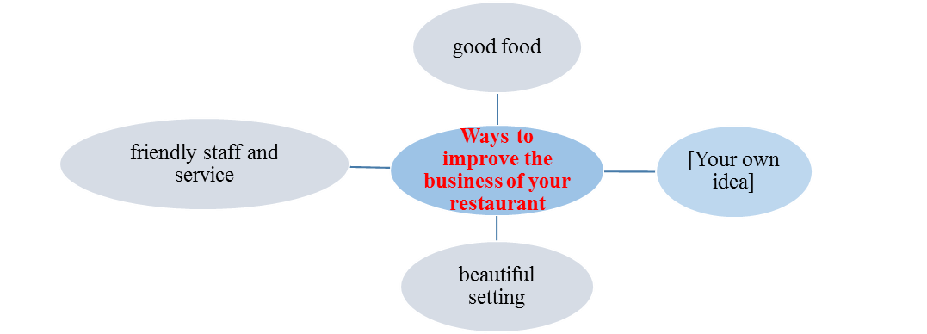
DE THI MOI DOT 8/11

Slide 29
benefits of going jogging
Improves Bone Strength
[Your own idea]
weary
Keeps the Mind Healthy

